Slide 1
A discussion of the census income dataset
Lucas Hurley McCabe


Slide 2
About the dataset
The dataset was extracted from the 1994 Census database. It can be found on the UC Irvine Machine Learning Repository.
The dataset consists of 48 842 individuals, each with 14 census attributes (age, education, marital status, etc.) and one binary target variable describing whether the individual earned greater than $50 000 that year.
Goal: to develop a model that predicts the income variable based on the 14 demographic attributes.

Slide 3
Data pre-processing
After cleaning and processing the data, there were over 100 features.
I selected the 24 features that were most strongly-correlated with whether an individual earned greater than $50,000.
We can summarize the topics of these 24 features with the following general descriptors: age, education, hours worked, net capital, occupation, marital status, family relationship, and sex.

Slide 4
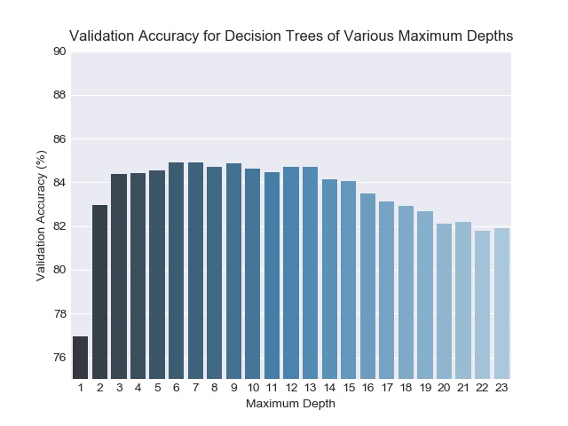
Decision tree model
The validation stage was used to optimize the maximum tree depth parameter.
The architecture with a maximum tree depth of seven nodes was selected.
Validation accuracy decreases after this point due to overfitting.

Slide 5
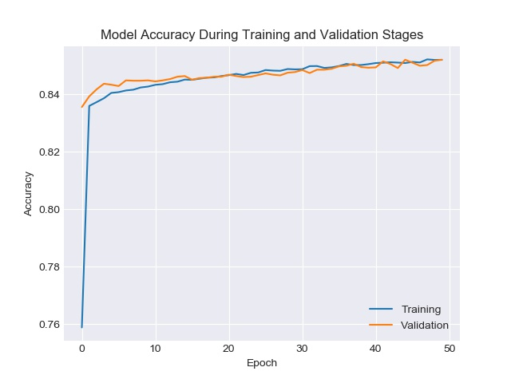
Multilayer perceptron model
The model shows comparable performance in training and validation, indicating that it did not overfit.
Accuracy is roughly 76% at epoch 0 because this is the performance of a naïve model that guesses everyone earns <=$50k.

Slide 6
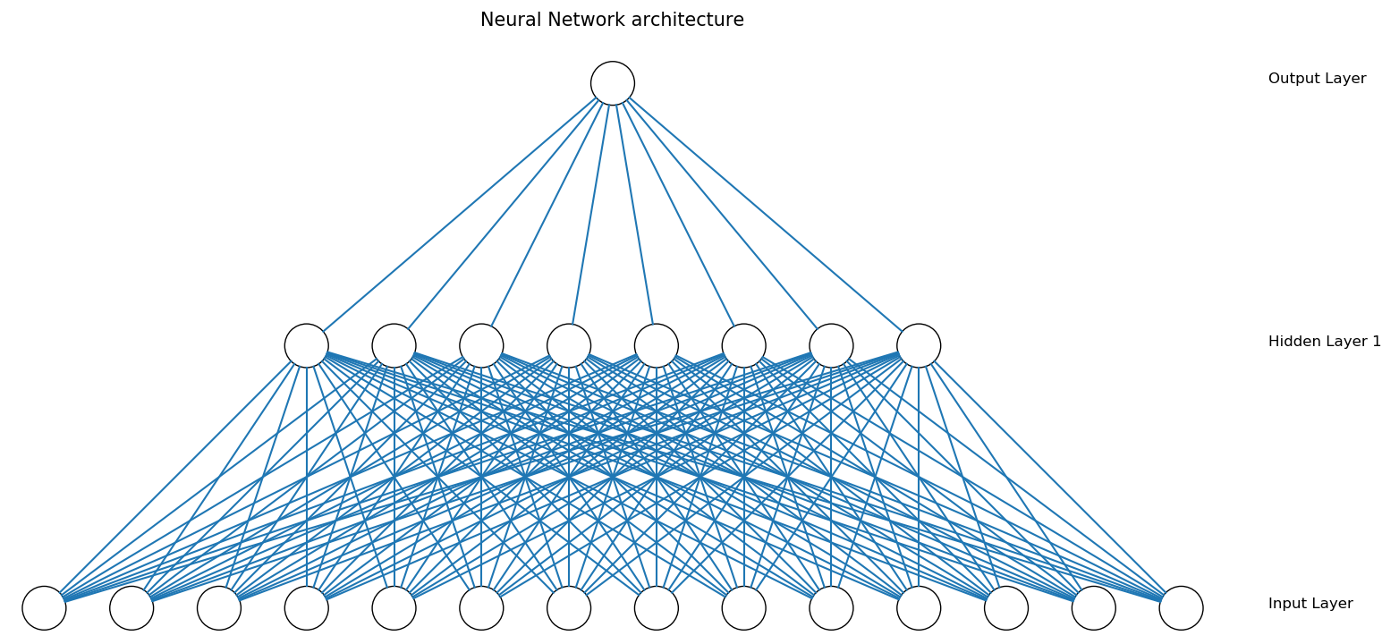
Multilayer perceptron model

Slide 7
“Feature importance” based on model architecture
Correlation Coefficient | Decision Tree Rank | Normalized MLP Weight
Married: civilian spouse | Married: civilian spouse | Hours/week
Relationship ID: husband | Net Capital | Net Capital
Education, number of years | Hours/week | Work Class: Private
Never married | Age | Education, number of years

Slide 8
overview
 | Decision Tree Model | Multilayer Perceptron Model
F1-Score | 0.5962 | 0.6464
Accuracy | 82.22% | 85.84%
Certainly, the multilayer perceptron model outperformed the decision tree classifier, but training took almost twice as long. Because the dataset is not extraordinarily large, the difference in training time is not prohibitive, so the multilayer perceptron model appears to be the best choice. We have shown that we can reliably predict with well above 80% accuracy whether an individual in the provided dataset earned more than $50,000.

